Slide 1
Introduction to Alternative Heating Systems
South West Chicken Association, April 2013

Slide 2

Agenda
Introduction
Challenges Facing Industry
Conventional Heating
Hot Water Heating Systems
Optimal Ventilation
Fuel Types

Slide 3
Agenda
Introduction
Challenges Facing Industry
Conventional Heating
Hot Water Heating Systems
Optimal Ventilation
Fuel Types

Slide 4
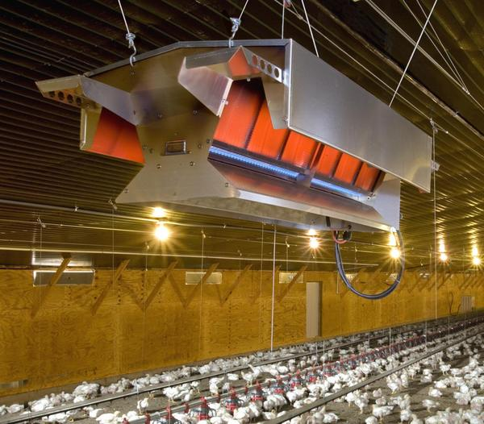
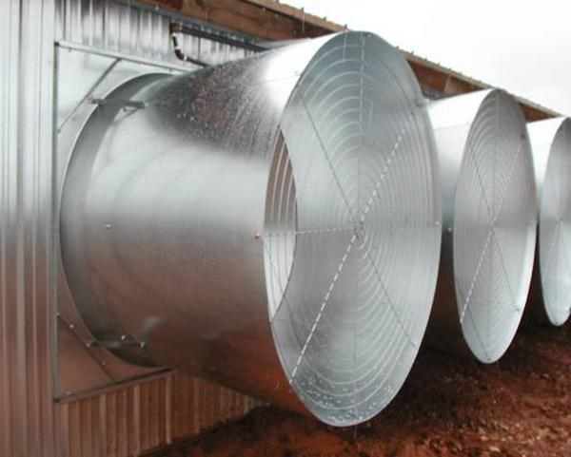
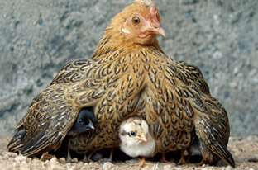
Challenges to the Industry
Heat & Power Intensive

Slide 5
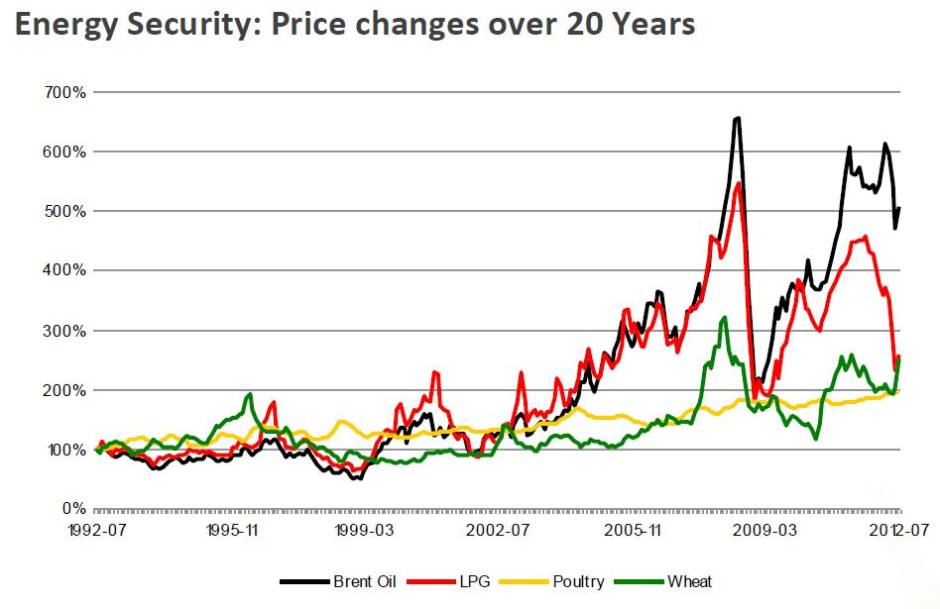
Challenges to the Industry
Source: USDA

Slide 6
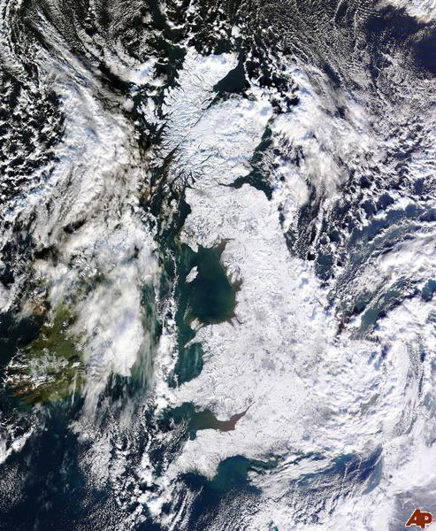
Challenges to the Industry
Growers vulnerable to wide variation in energy prices and usage.

Slide 7
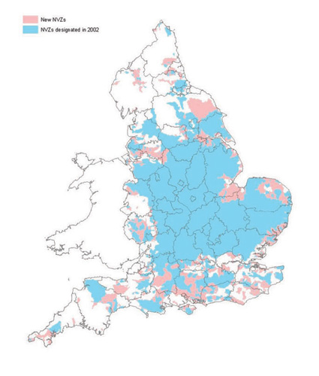
Challenges to the Industry
Increasing environmental constraints add costs
E.g. Nitrates Directive restricts land application of manures.

Slide 8
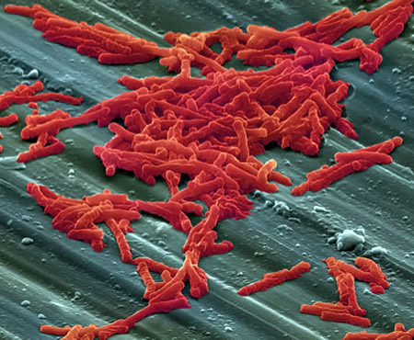
Challenges to the Industry
Increasing restriction on anti-microbial use
Providing an optimum house environment is critical in supporting bird’s immune system

Slide 9
Agenda
Introduction
Challenges Facing Industry
Conventional Heating
Hot Water Heating Systems
Optimal Ventilation
Fuel Types

Slide 10
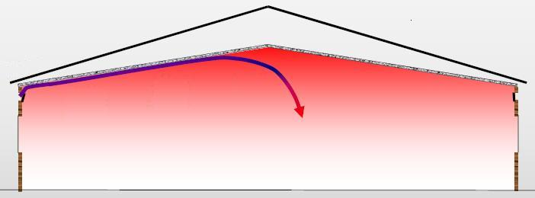

First, and Most Importantly
Regardless of heating method…….
houses should be well insulated and “Tight”
100%
5°C
15°C
50%
25°C
25%
10°C
70%
Kind permission of Mike Czarick, UGA

Slide 11
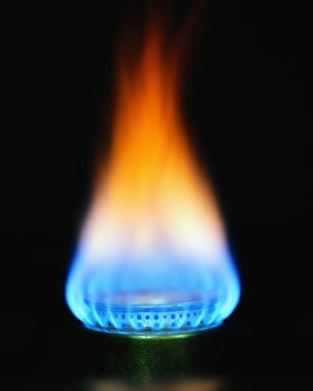
Conventional Heating
Tried and trusted technology
Relative cheap to install and maintain
“Responsive” form of heat

Slide 12
Conventional House Heating
Conventional LPG heating produces water as a by-product. (1 litre LPG = 0.8L Water)
Carbon Dioxide
Propane
Oxygen
Water
C₃H₈ + 5 O₂ → 3 CO₂ + 4 H₂O
Ventilation increases by a third simply to remove moisture created by LPG combustion!

Slide 13
Agenda
Introduction
Challenges Facing Industry
Conventional Heating
Hot Water Heating Systems
Optimal Ventilation
Fuel Types

Slide 14
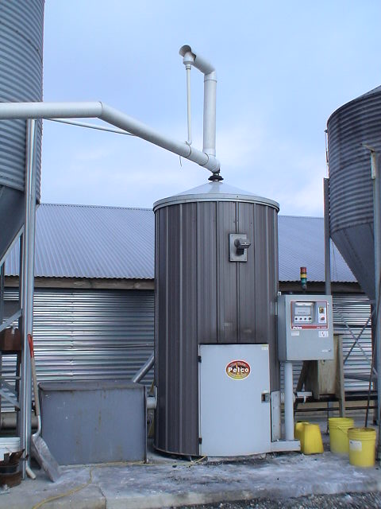
Alternative Heating Systems
There are basically two types of alternative heating systems (do not burn propane/natural gas)
  Hot air systems
  Hydronic (Hot Water) systems
Kind permission of Mike Czarick, UGA

Slide 15
Water Heating Systems
There are typically four different types of heat exchangers used in Hydronic Systems:
  Black Steel Pipes
  Finned Tubes
  Radiator Fans
  Under Floor Heating
Kind permission of Mike Czarick, UGA

Slide 16
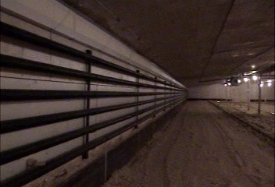
Black Steel Pipe
Kind permission of Mike Czarick, UGA

Slide 17
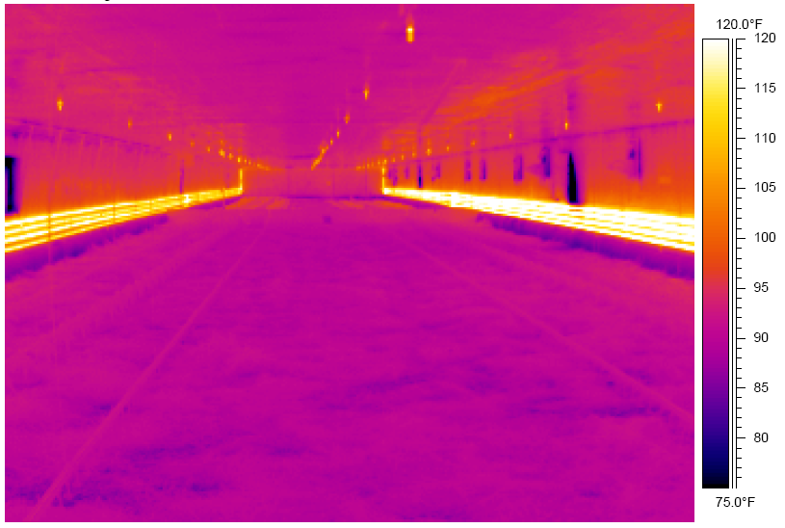
Thermal image of hot water pipes
32°C
Kind permission of Mike Czarick, UGA

Slide 18
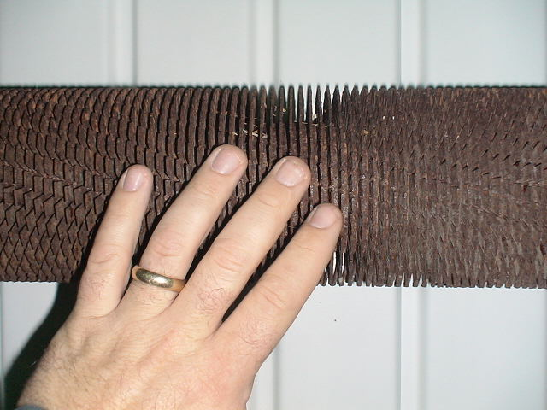
Finned tubes
Finned tube
  More surface area
  More heating produced per metre
  Less pipe required
Kind permission of Mike Czarick, UGA

Slide 19
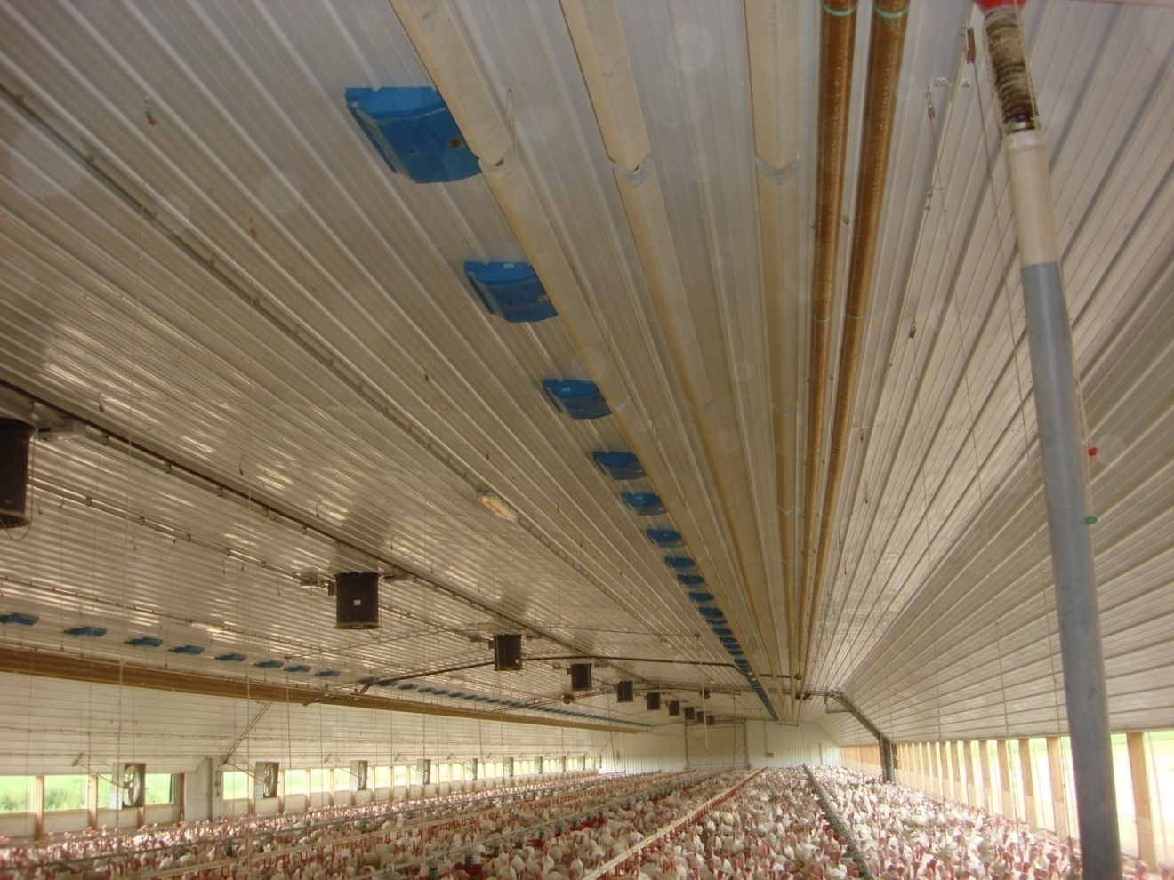
Finned tubes
Traditionally installed in vicinity of air inlets, warming cold incoming air.
Kind permission of Mike Czarick, UGA

Slide 20
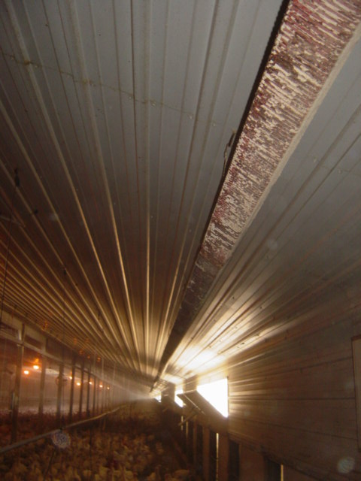
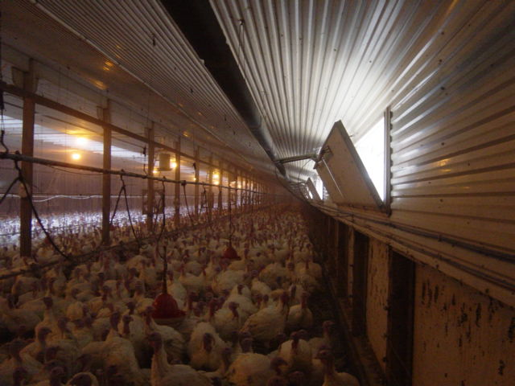
Finned tubes
Located on ceiling
near air inlets
Kind permission of Mike Czarick, UGA

Slide 21
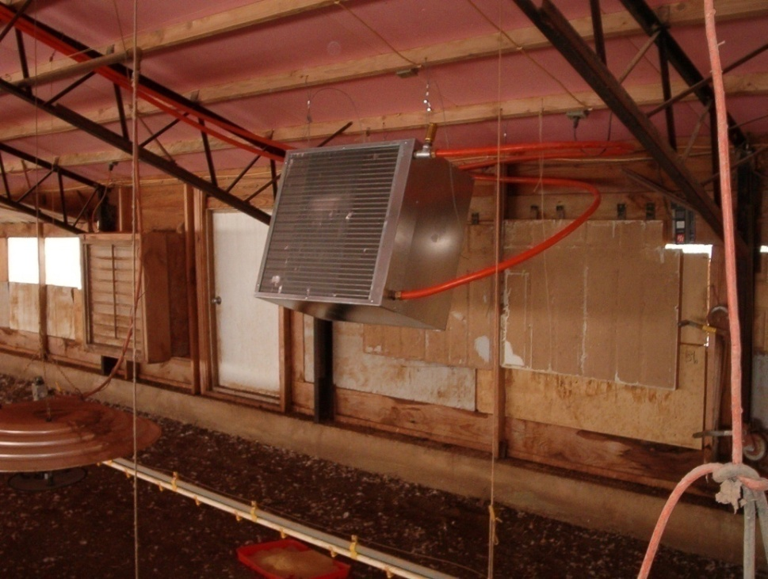
Individual Radiators with Fans
Individual radiators with blower fans
  Lower cost option
  Similar to forced air furnaces but air produced is not as hot.
Kind permission of Mike Czarick, UGA

Slide 22
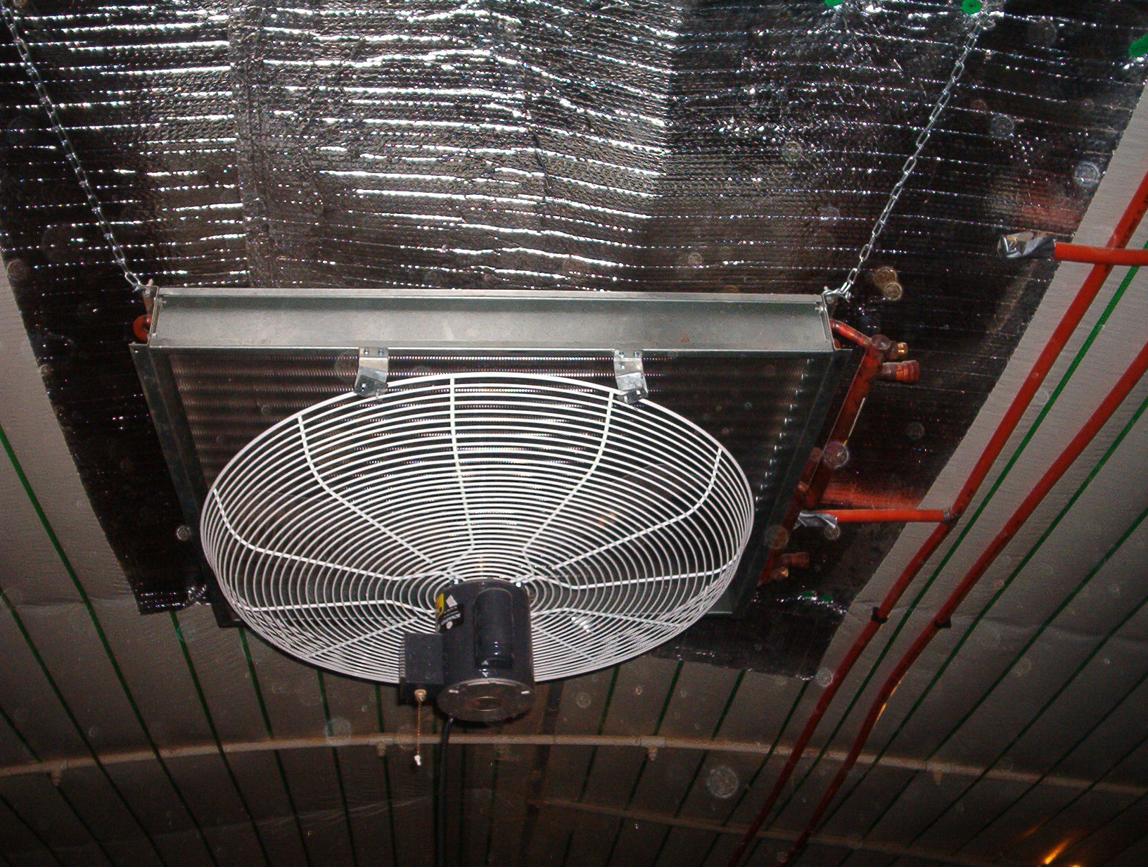
Radiator fan located next to ceiling
Kind permission of Mike Czarick, UGA

Slide 23
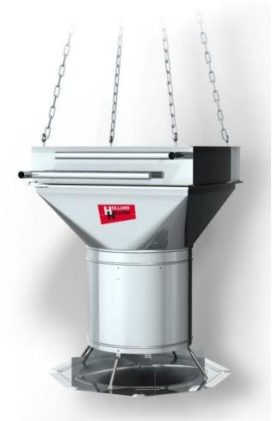
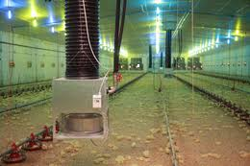
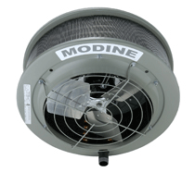
Suspended from Ceiling

Slide 24


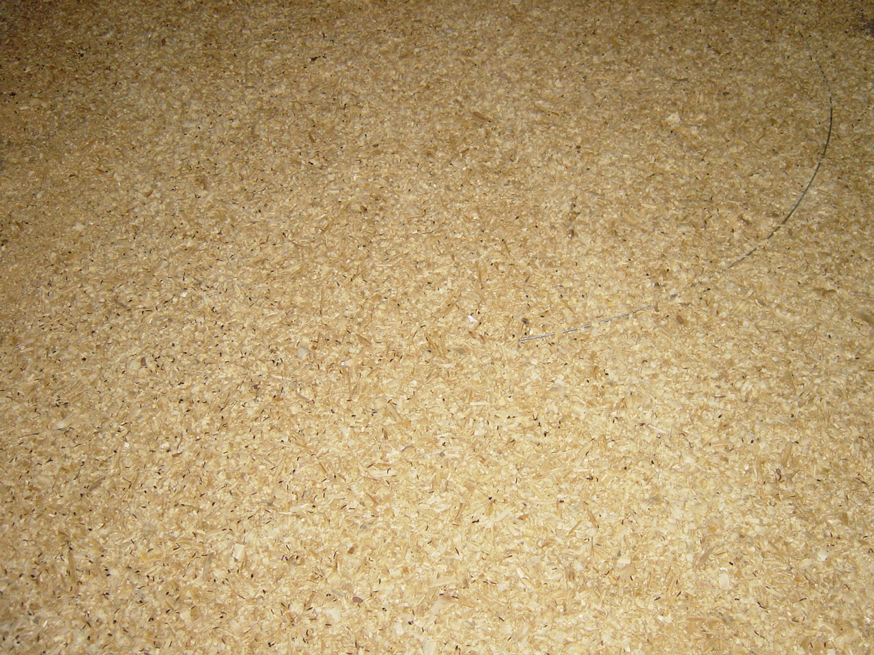
Floor heating systems
Concrete floor with pipes running through it
Kind permission of Mike Czarick, UGA

Slide 25
Thermal images of floor

Slide 26
Floor Heating Systems
Floor heating:
  Primarily designed to provide background heat
  Tends to have a very slow response time
Yes, the litter tends to be dry but this tends to be true with any hydronic system
Not a very common type hydronic heating system – cost
Kind permission of Mike Czarick, UGA

Slide 27
Agenda
Introduction
Challenges Facing Industry
Conventional Heating
Hot Water Heating Systems
Optimal Ventilation
Fuel Types

Slide 28
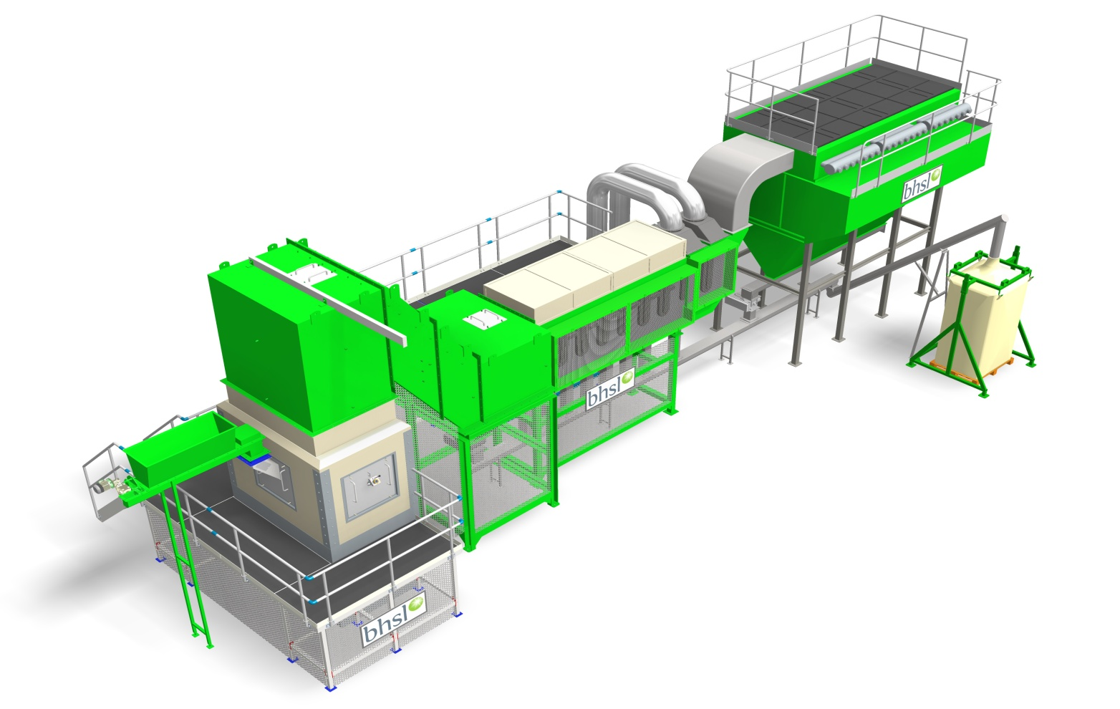
Bhsl FBC
The only farm sized technology guaranteed
to work with Poultry Manure as a fuel.

Slide 29
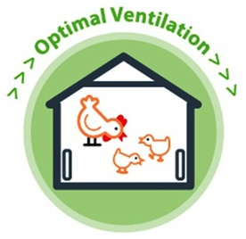
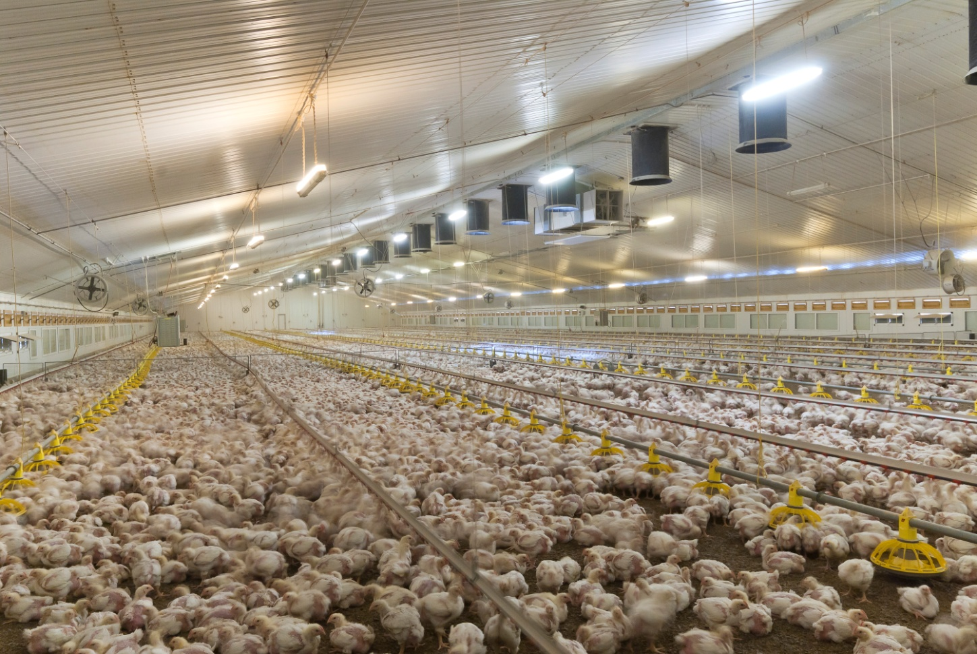
Optimal Ventilation
A clean source of abundant heat to optimise environmental conditions
A departure from a “Minimum” ventilation strategy

Slide 30
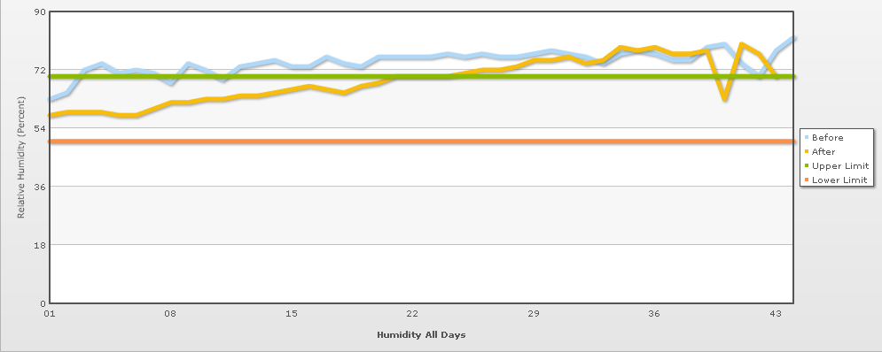
Relative Humidity is Key

Slide 31
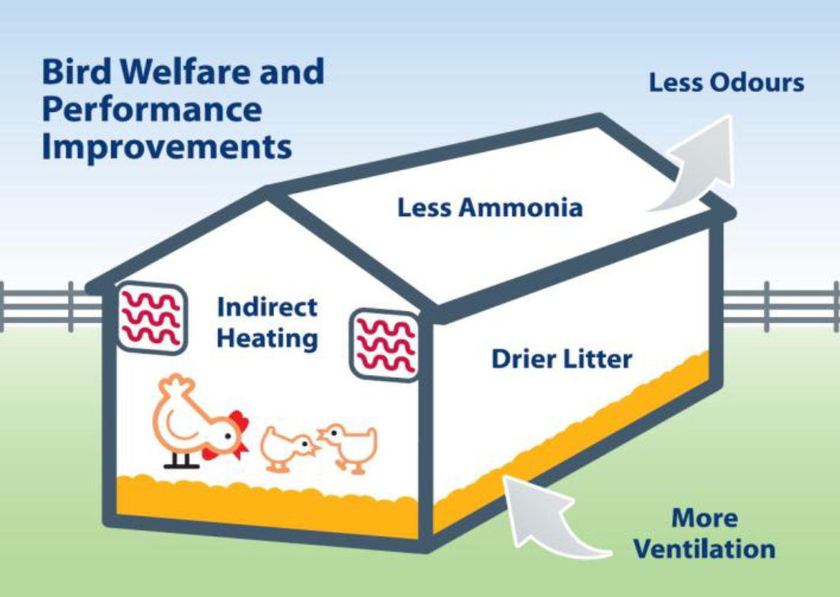
Bird Benefits
5 point improvement in FCR
20 point improvement in EPEF
50% reduction in Pododermatitis
25% reduction in Hock Burn

Slide 32
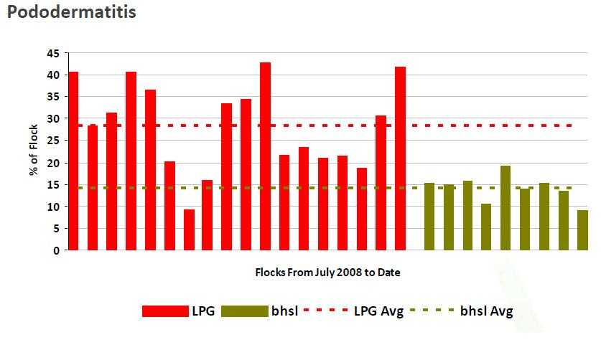
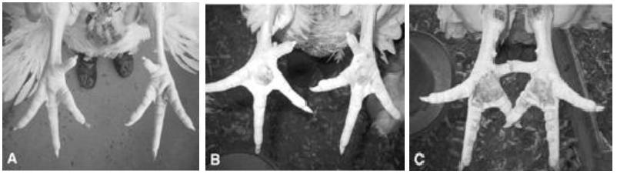
Pododermatitis

Slide 33
Grower Benefits
Reduction in LPG used
Renewable Heating Incentive (RHI)
Security of Energy Supply
Ash Sales (Rich in Phosphorus and potash*)
Cost Certainty
Easier Litter Management
Improved Working Conditions
*utilising poultry manure

Slide 34
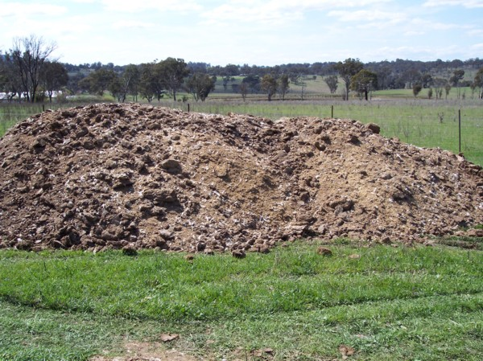
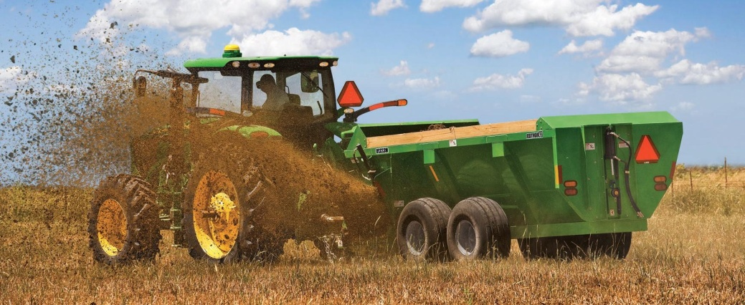
Environment Benefits
Creates a sustainable alternative to land application
Nutrients are more readily recycled as Ash
Lower Carbon Footprint
Less Ammonia created
at source

Slide 35
Agenda
Introduction
Challenges Facing Industry
Conventional Heating
Hot Water Heating Systems
Optimal Ventilation
Fuel Types

Slide 36
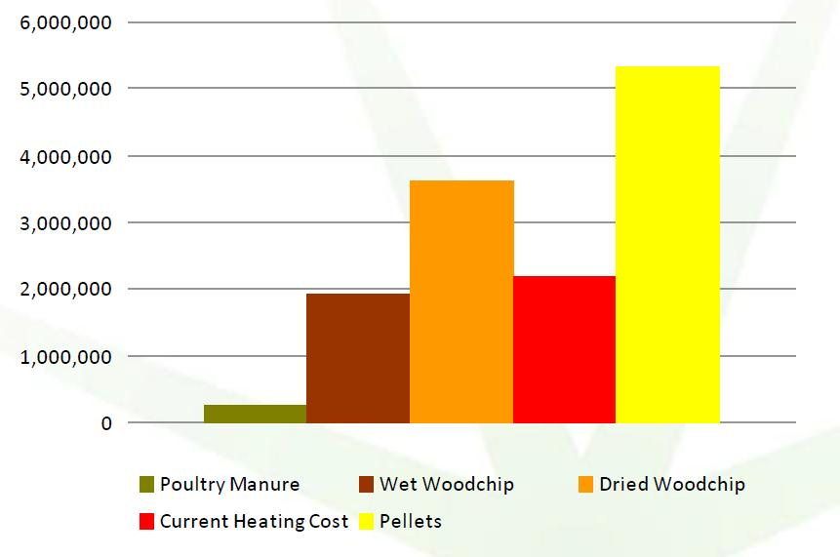
Fuel Types
A number of biomass fuels are available
In energy terms Pellets are now the same cost as LPG and the cost of Dry Woodchip (30% Moisture) has increased to approx. £110/tonne.
Current cheapest available fuel is Wet Woodchip at approx. £38/tonne.
20 Year Fuel Comparison*
* Example 6 House Farm

Slide 37
Which Fuel?
20 Year Fuel Costs on 350k Bird Farm*
Wet Woodchip for 20 years saves nearly £3.3m compared to LPG and is £1.9m less than Dry Woodchip.
The ideal is to use Poultry Manure and Save nearly £5m over LPG.
*based on annual 150 kW/ m²

Slide 38

Thank you for your time
Any Questions?

