Slide 1

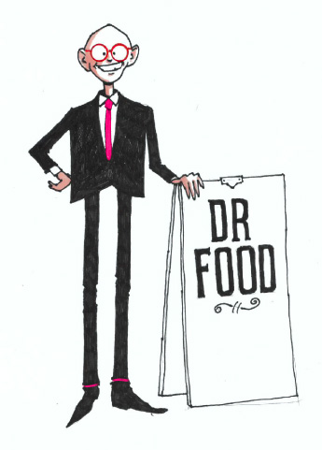
Can Chicken Continue Its Bull Run or are We Approaching Peak Chicken?
Dr. David Hughes
Emeritus Professor of Food Marketing
36th South West Chicken Association Conference
Sandy Park, Exeter, Devon
Tuesday, April 29th, 2025
www.supermarketsinyourpocket.com

Slide 2
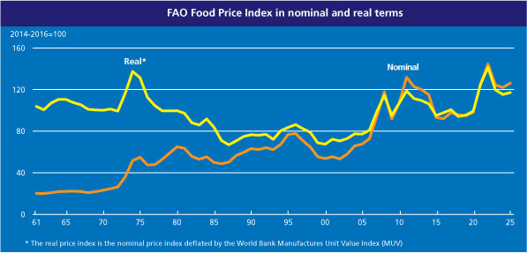

In March, 2025, The FAO Global Food Price Index was 7% Higher than a Year Previous.
What’s Vexing Consumers is that Global Food Prices are 34% Higher than Pre-Covid
But, Their Household Incomes haven’t Seen a Similar Rise!
Source: FAO April 4th, 2025

Slide 3




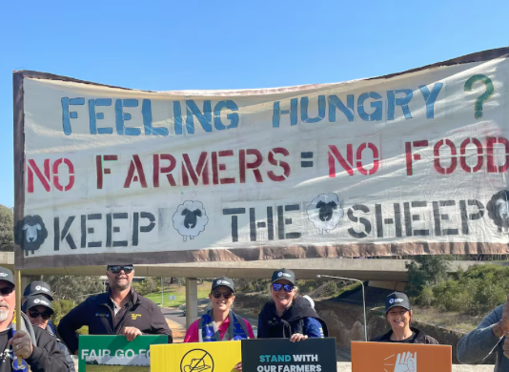


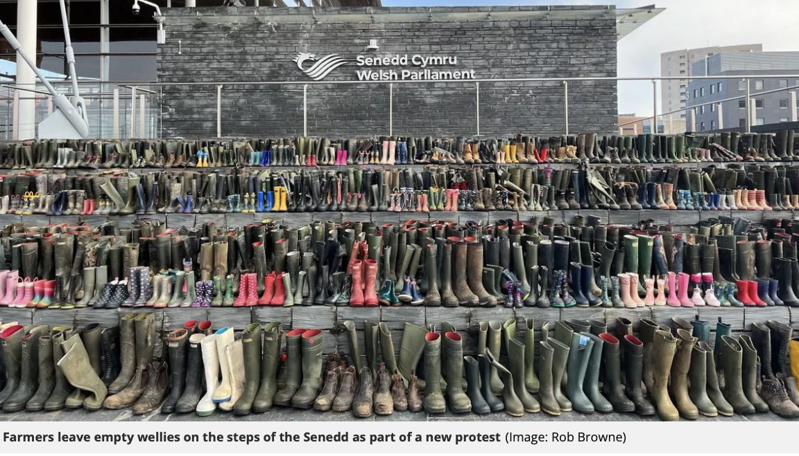
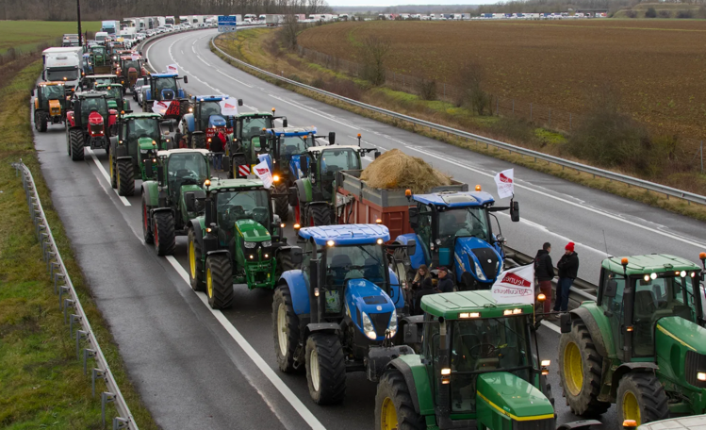




So, Higher Global Food Prices.
Happy Farmers Around the World?!

Slide 4
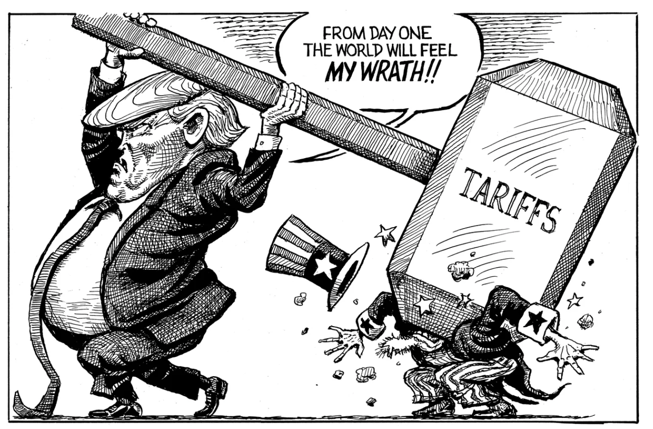
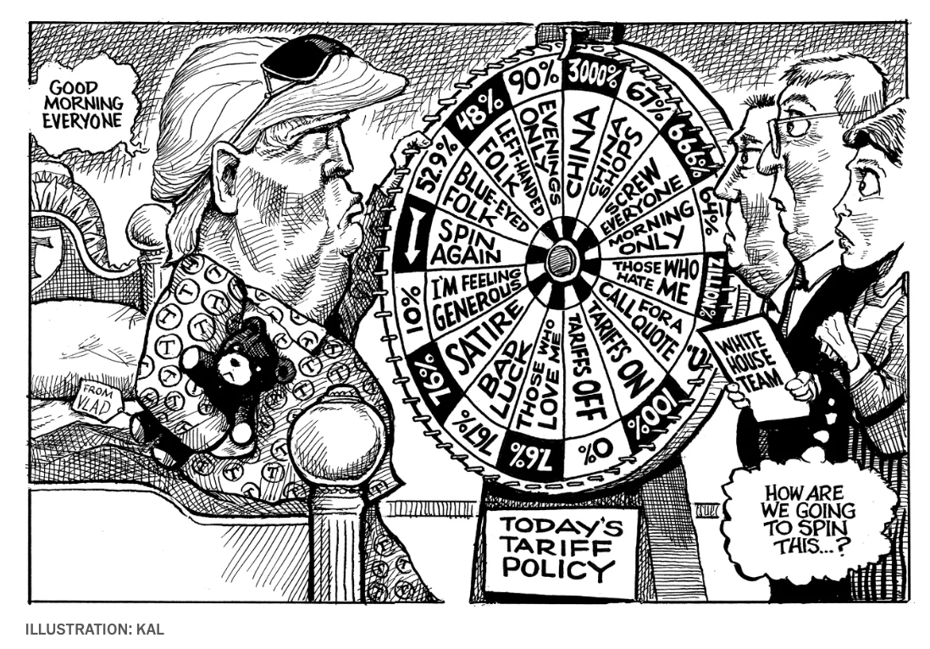
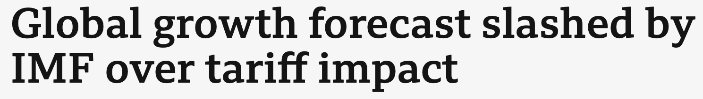



And His Insightful View on Pres. Trump’s
Current Tariff Policy!
A Prescient “Kal” Cartoon Prior to Pres. Trump’s Inauguration!
April 22nd, 2025
November 28th, 2024 &
April 18th, 2025

Slide 5

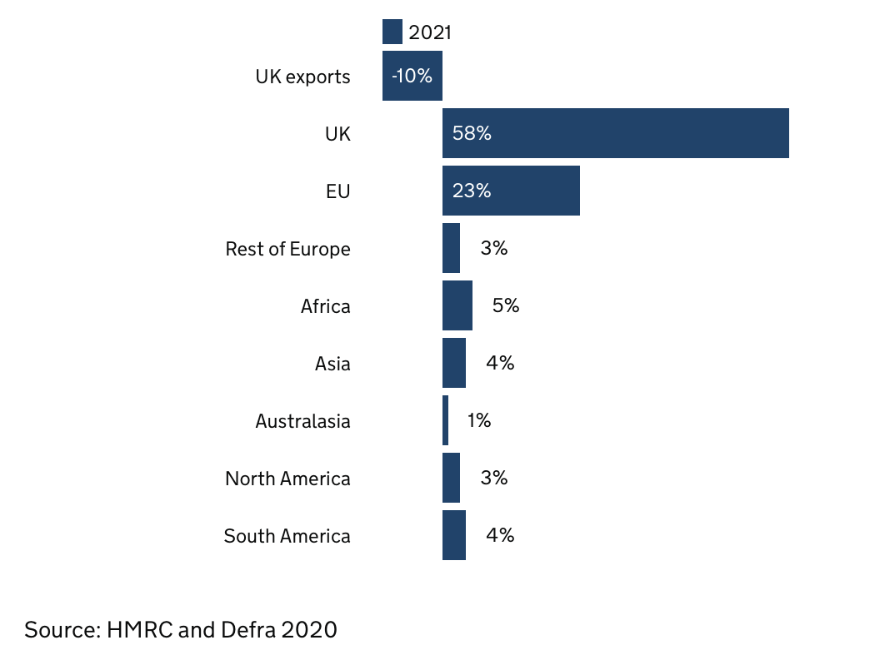
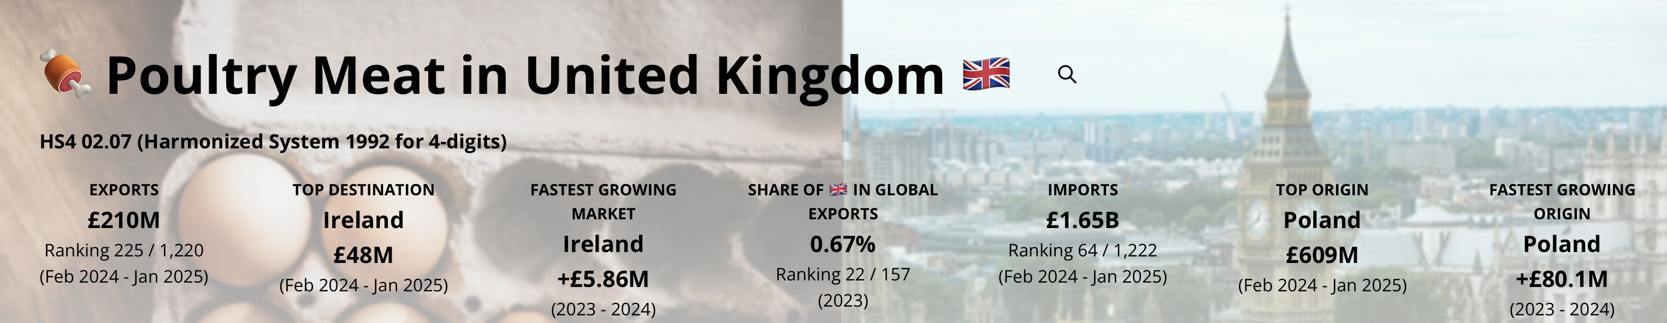

Where Does the Food We Eat in The UK Come From?
The UK is a Significant
Poultry Meat Importer
…. mainly from Europe.
Poultry Self-Sufficiency
has Declined from around
90% to 80% over past 4 Years.

Slide 6
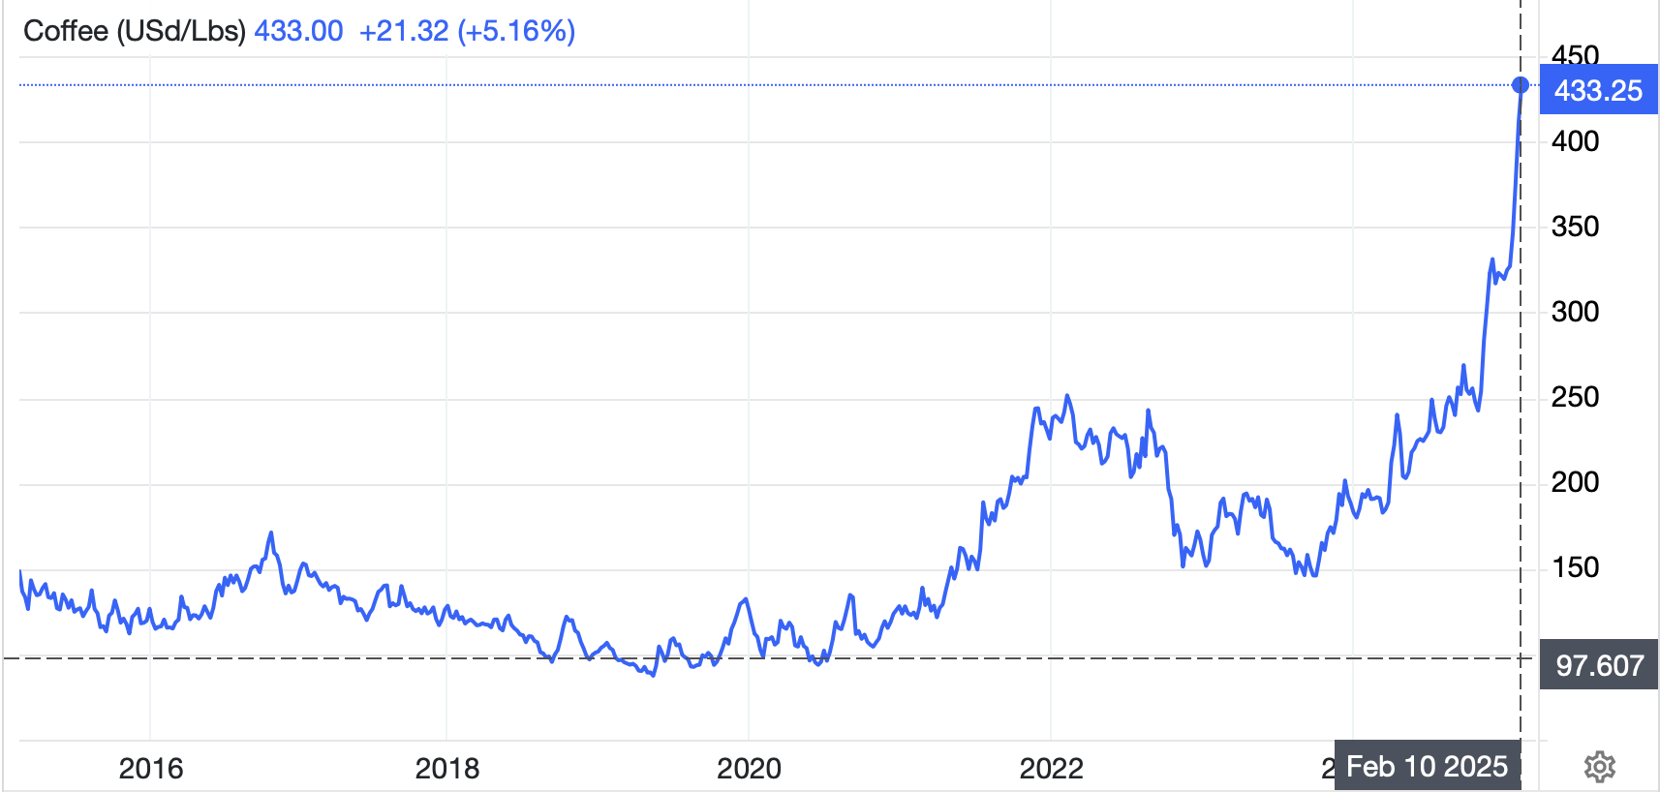
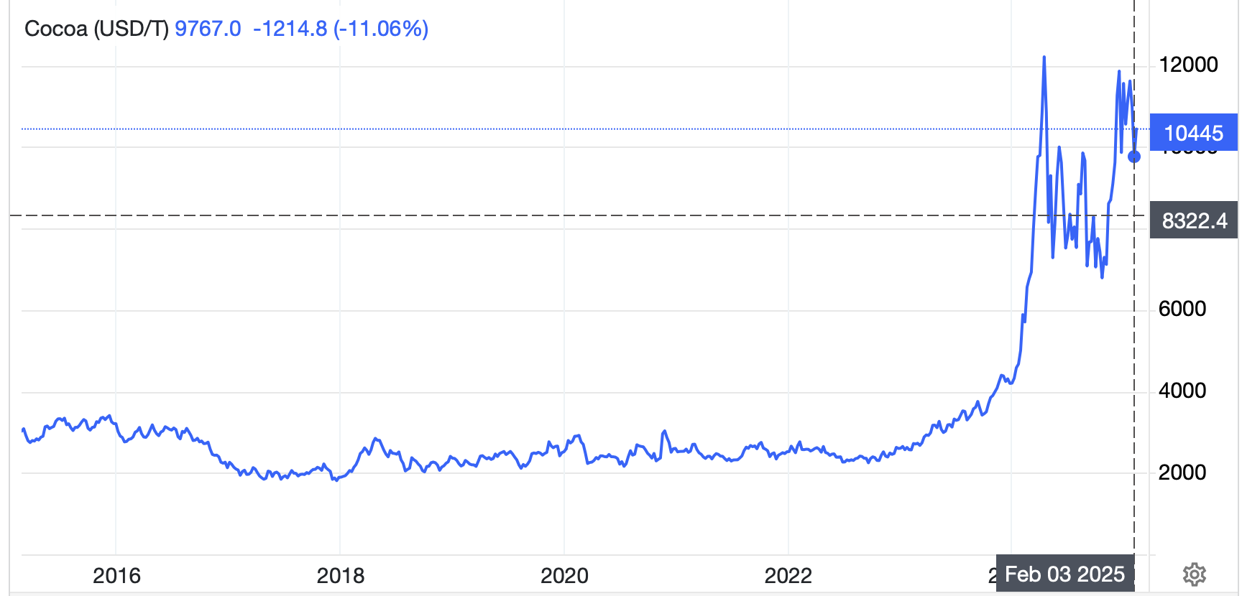
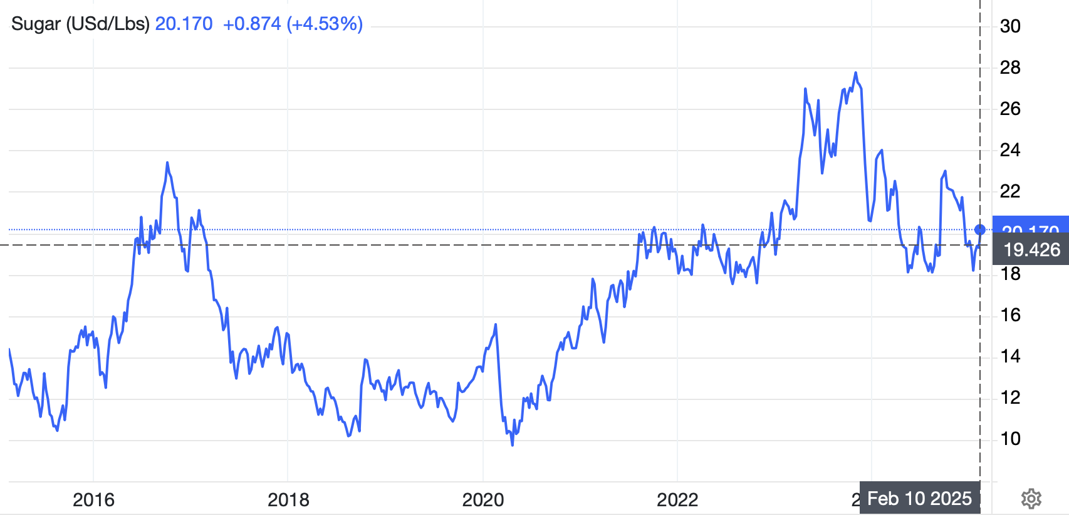

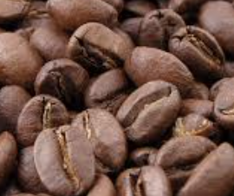





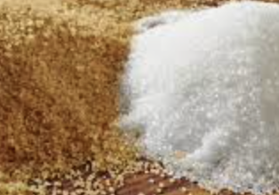
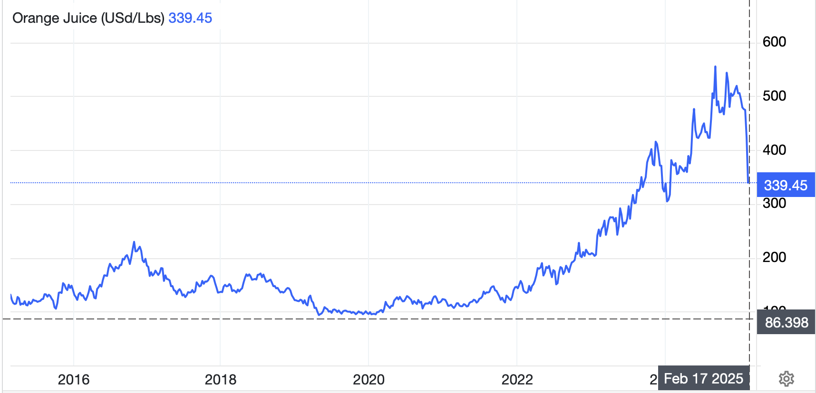

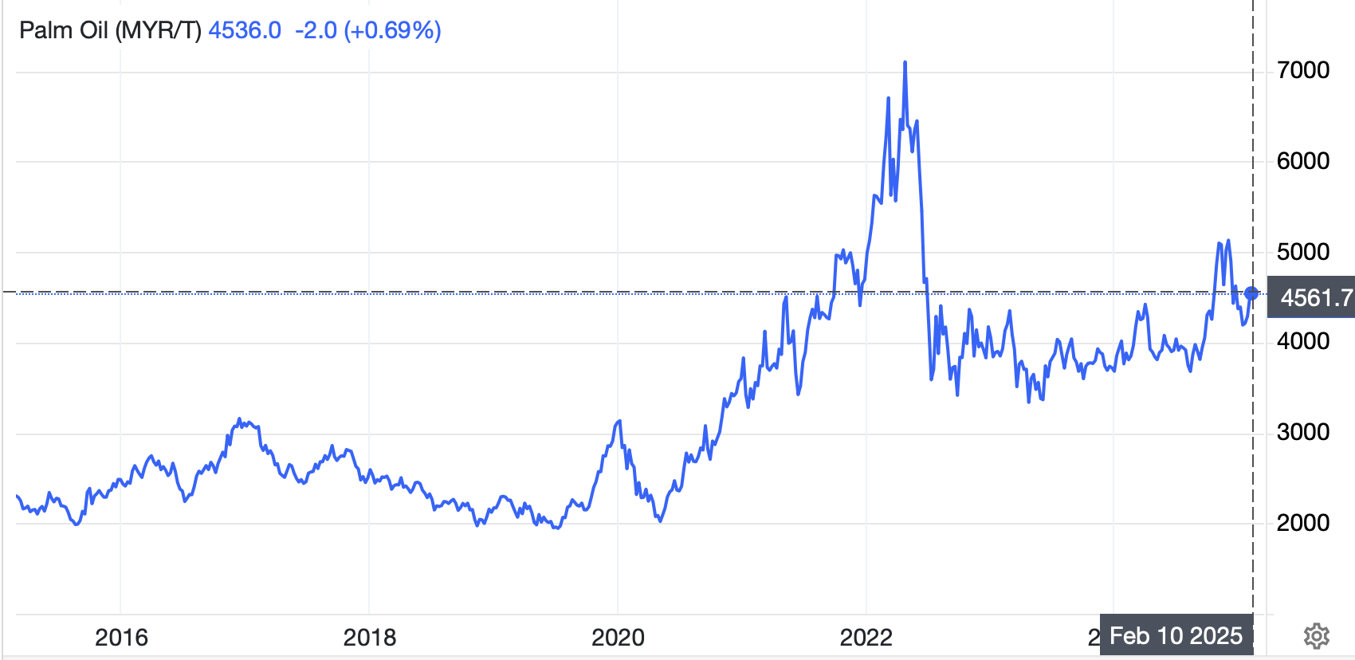
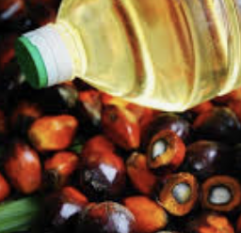
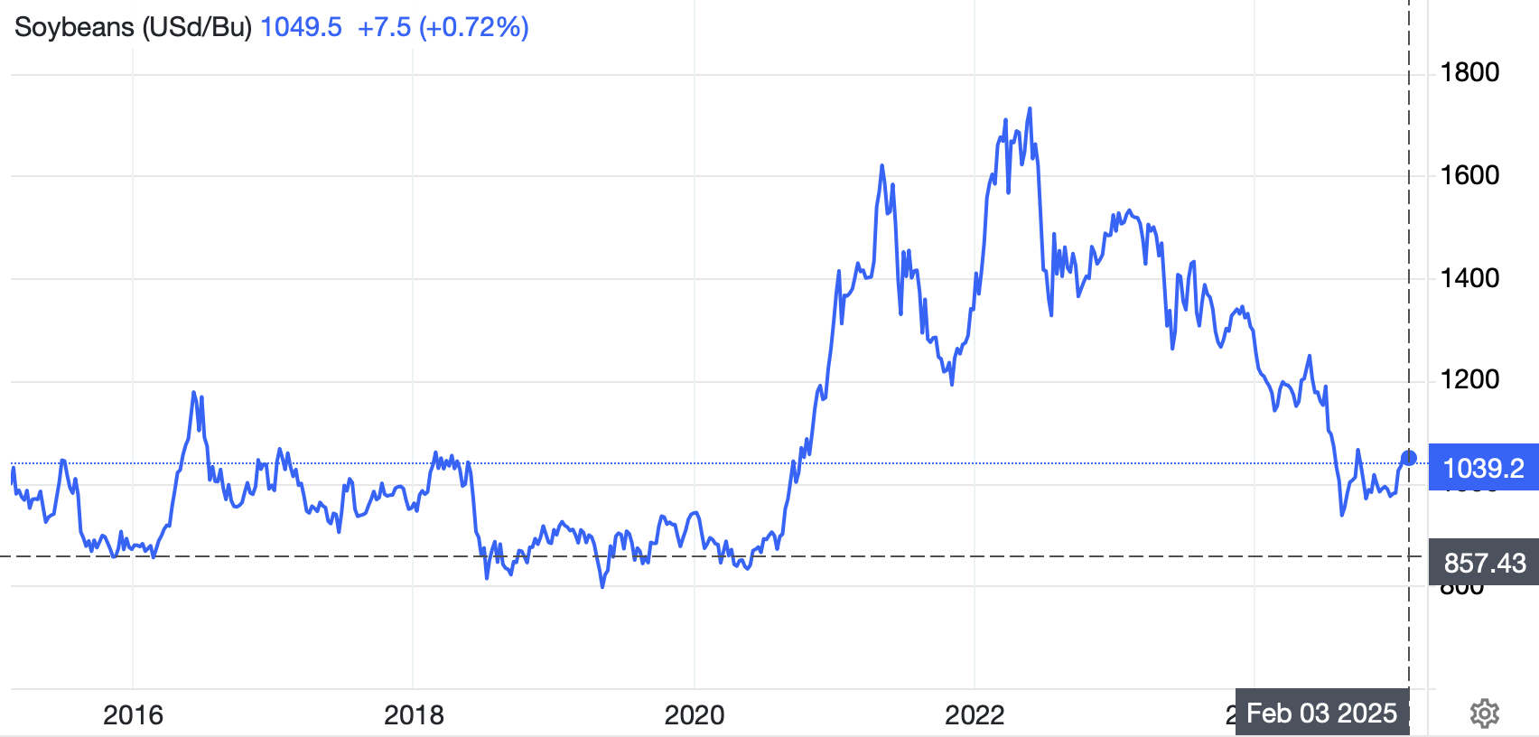



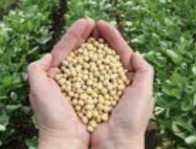

High Proportion of World Exports of Some Key Food Industry “Soft Commodities” Produced in Few Countries!
55% world production
45% world production
50% world production
Brazil is an Agribusiness “Powerhouse”!
(75% of the World’s Orange Juice, too).
82% of world production
68% of world production
10 Year Price Series to Mid-Feb., 2025
Soybeans, Palm Oil and Sugar have
dual domestic use in ethanol/bio-diesel.

Slide 7
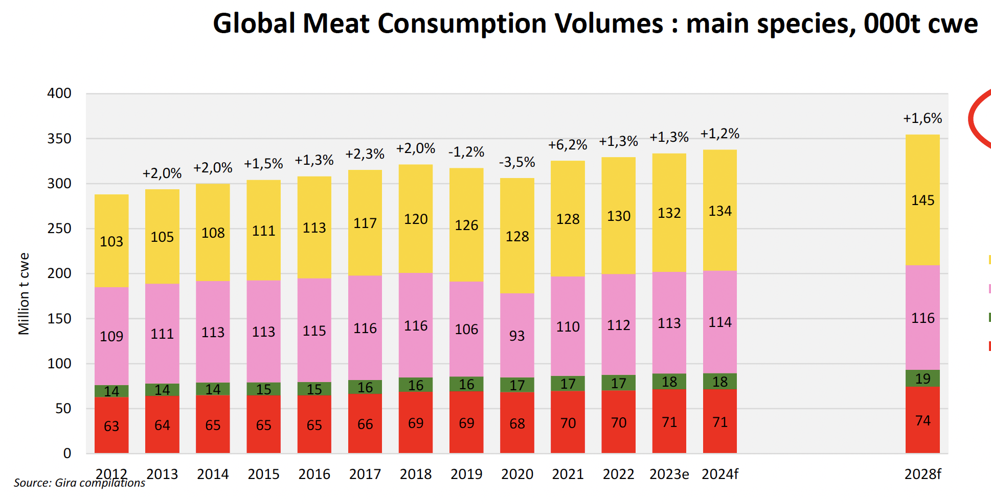


Global Meat
Market Shares:
2012
Pork 38%
Chicken 36%
Beef 22%
Lamb 5%
2024
Chicken 40%
Pork 34%
Beef 21%
Lamb 5%
All Meats are in Growth, BUT Chicken Continues its Inexorable Increase in Meat Market Share.
Pork and Beef Market Growth is Constrained by Religion given the Fast Growth in Moslem &
Hindu Populations, and by Demography, e.g. for Pork, given the Ageing Chinese Population.

Slide 8



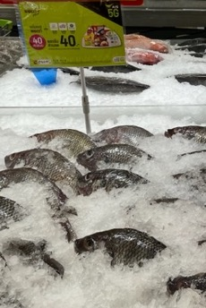
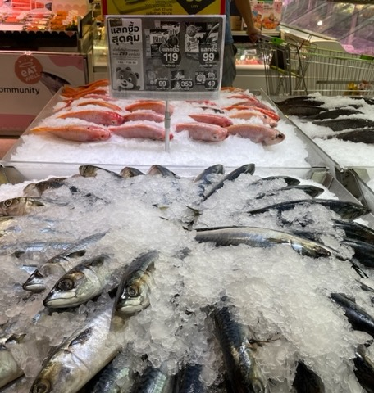

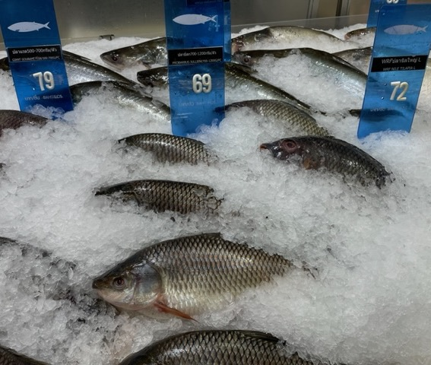
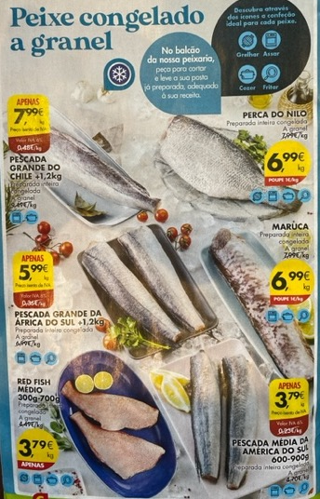


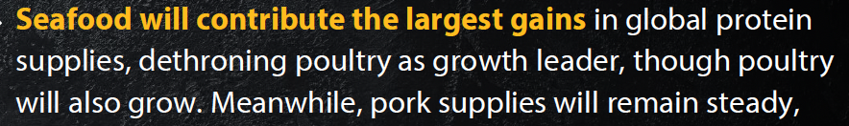
Fish & Seafood are Preferred Meat Proteins in Much of Asia.
Some Farmed Fish Compete Closely with Chicken on Price
Seafood is No. 1
in Portugal, too!

Slide 9
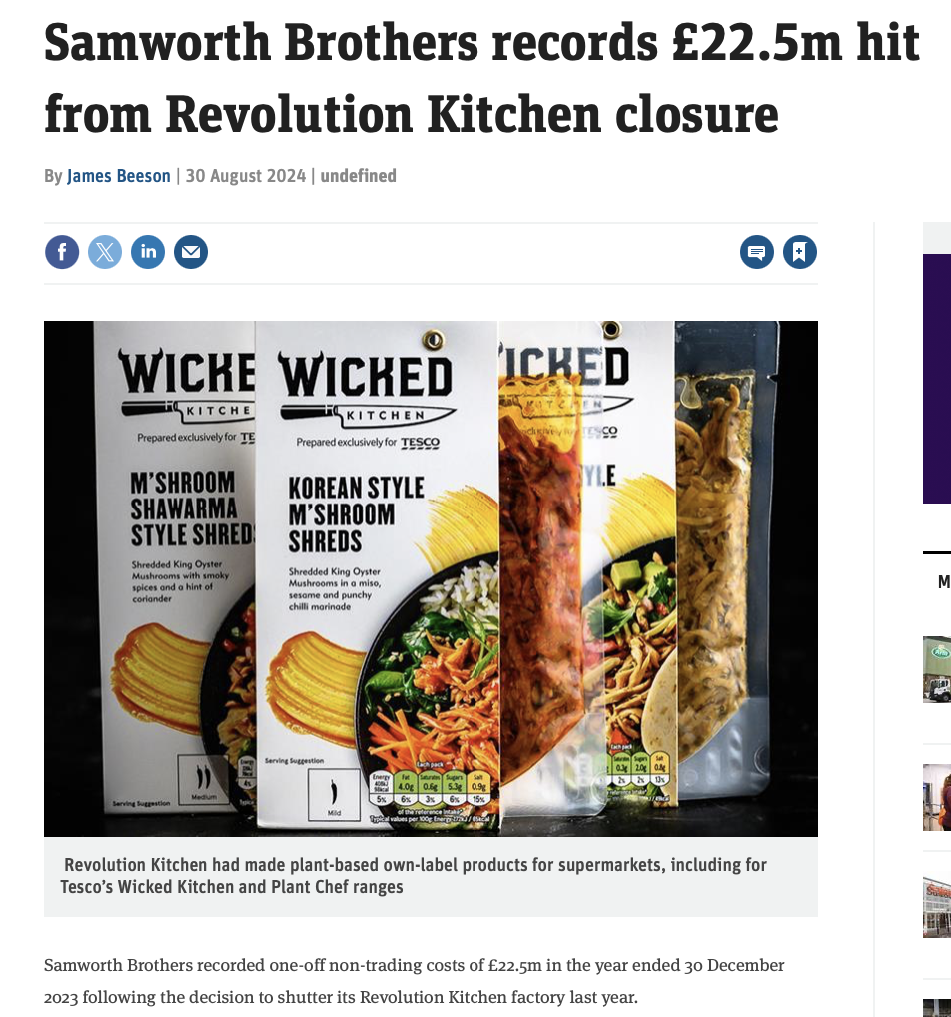
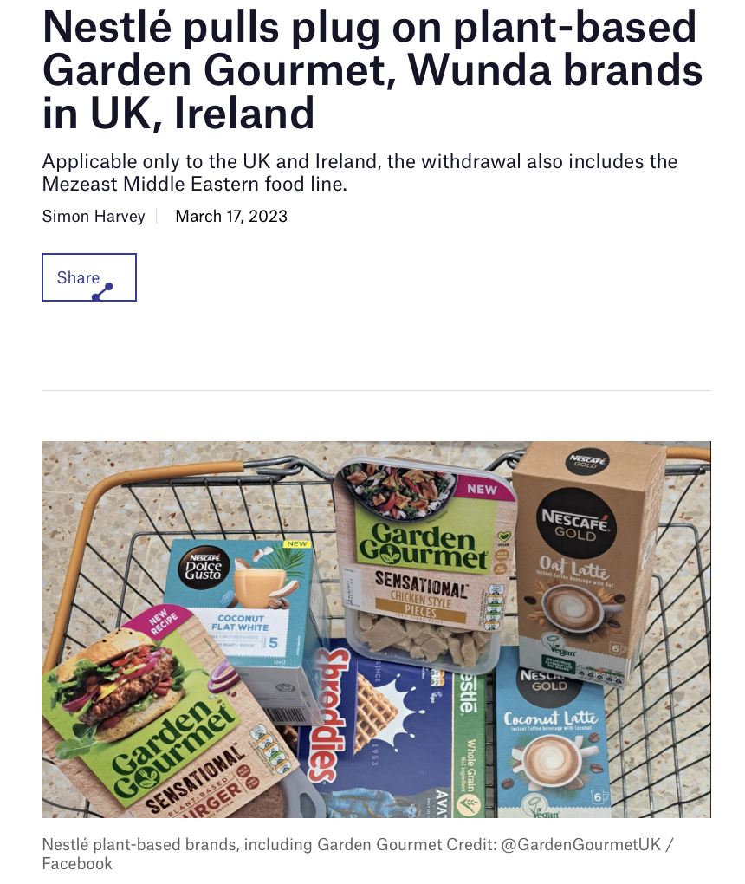
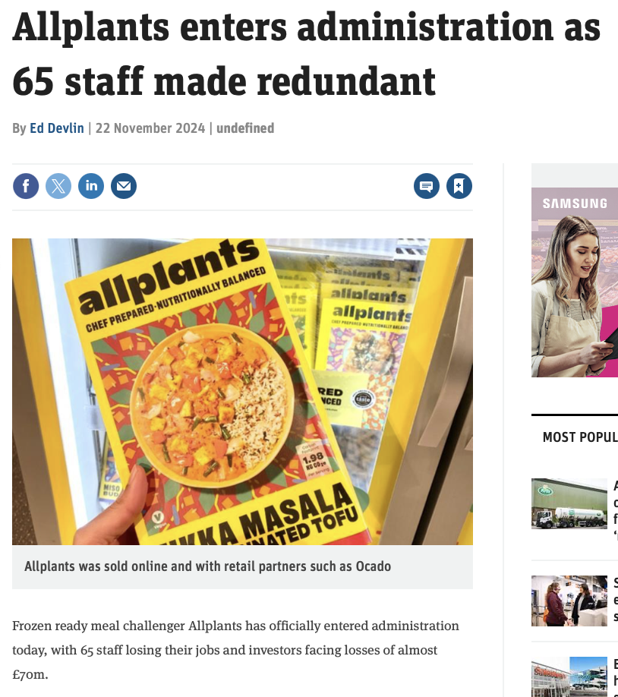
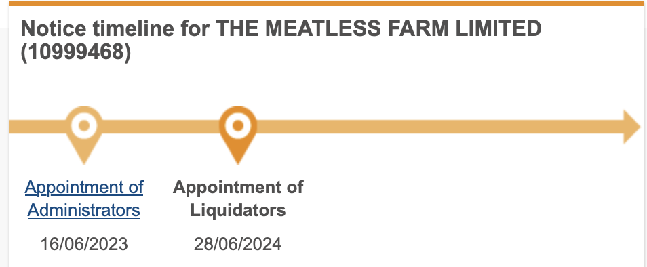
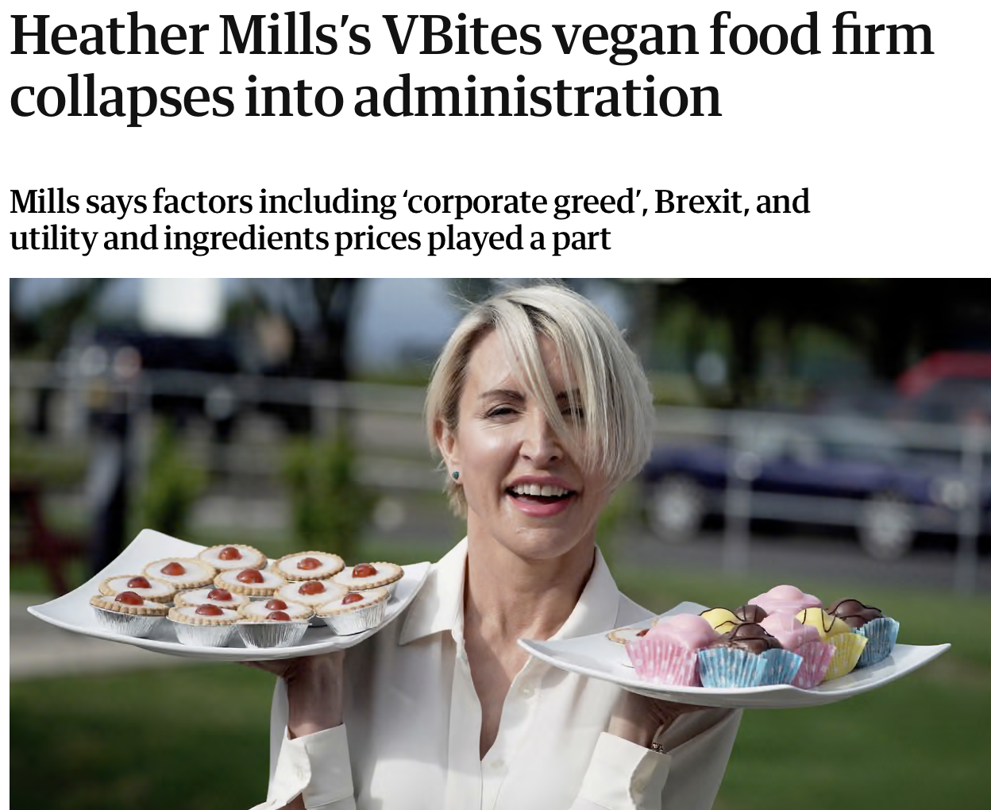


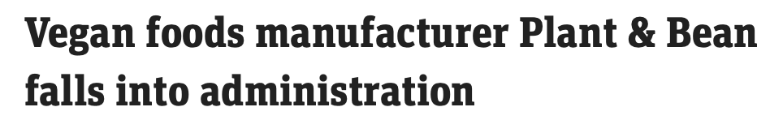
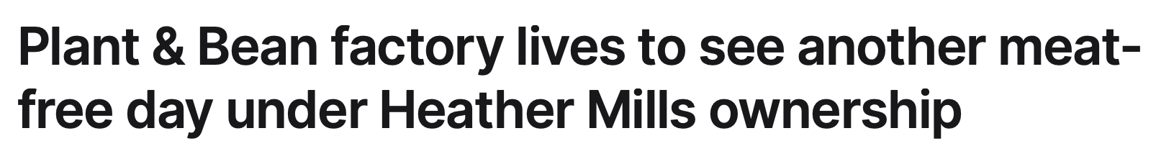
Aug. 30th
2024
March 17th, 2023
Nov. 22nd 2024
Tough Trucking in UK Plant-Based!
December 11th 2023
November 27th 2024
July 6th 2023

Slide 10




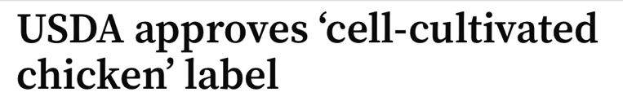

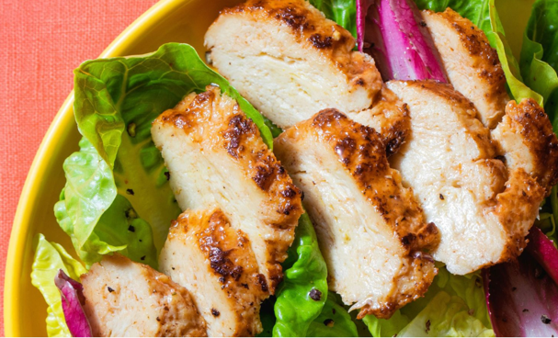

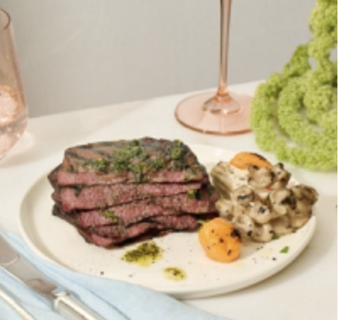
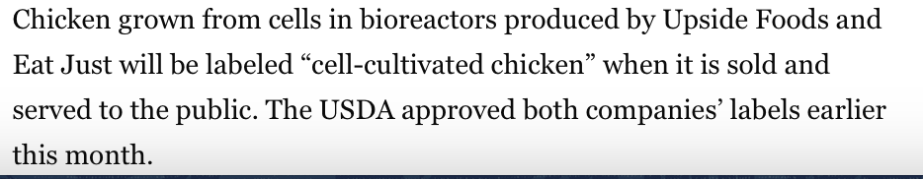

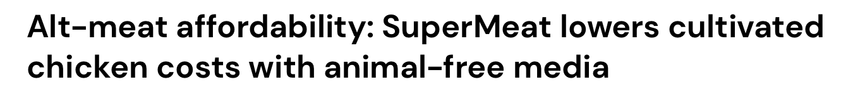



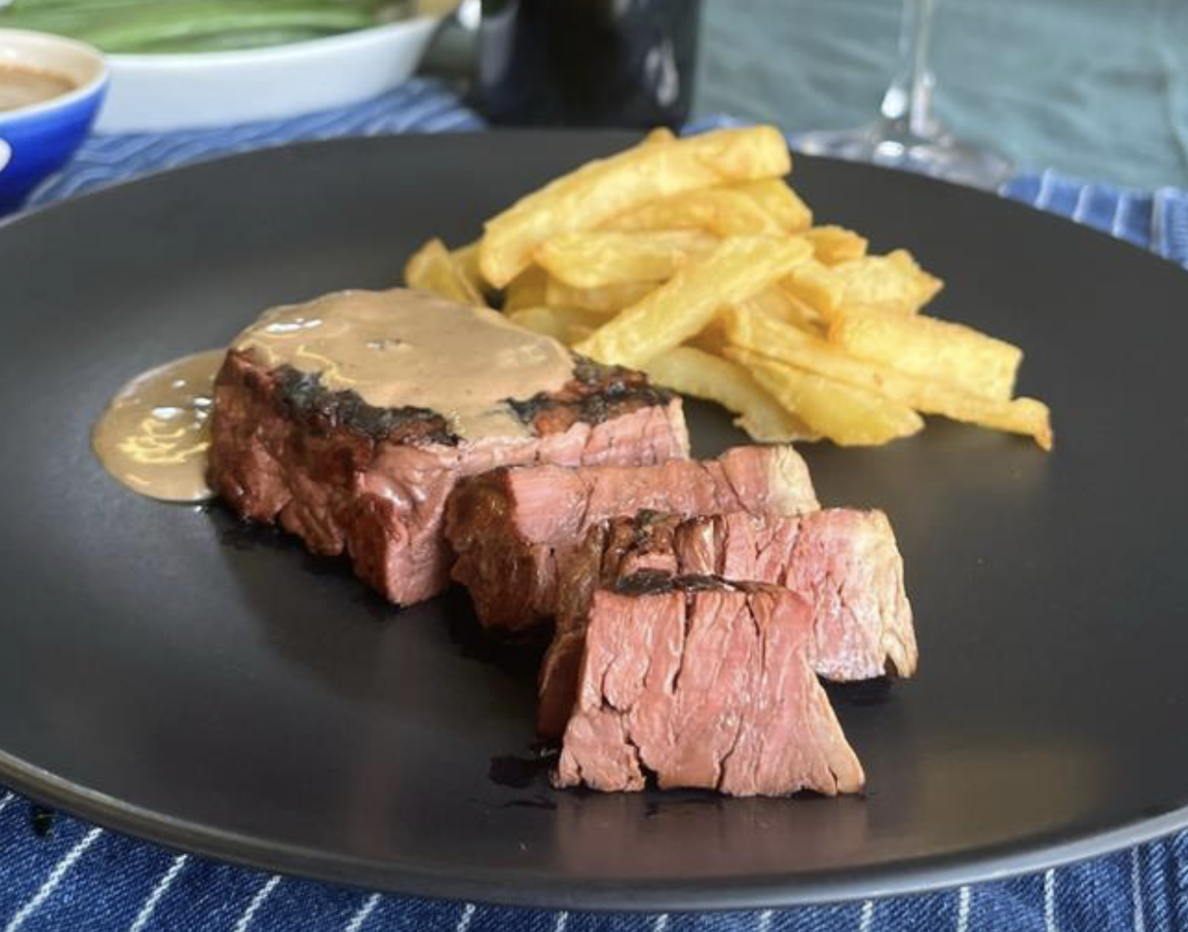
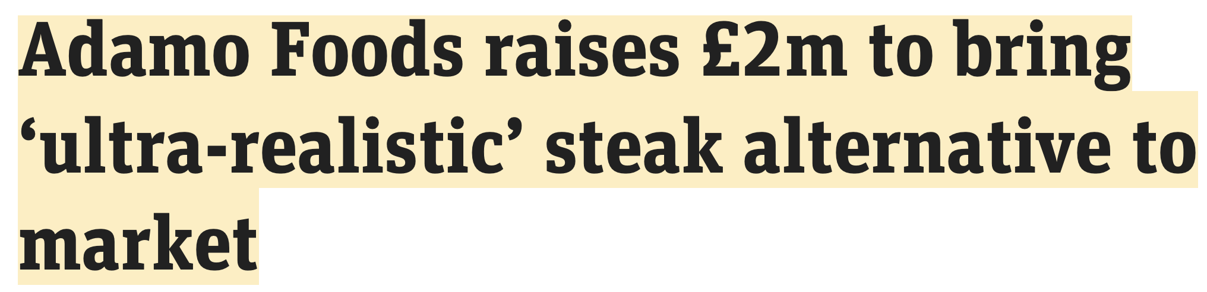
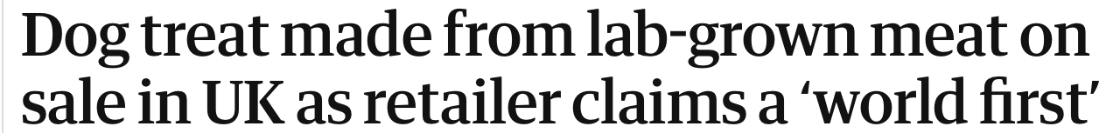

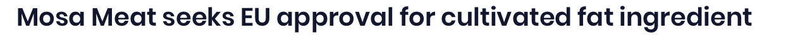

July 26th, 2023
June 14th, 2023
November 18th, 2024
August 12th, 2024
February 6th, 2025
January 23rd,
2025

Slide 11
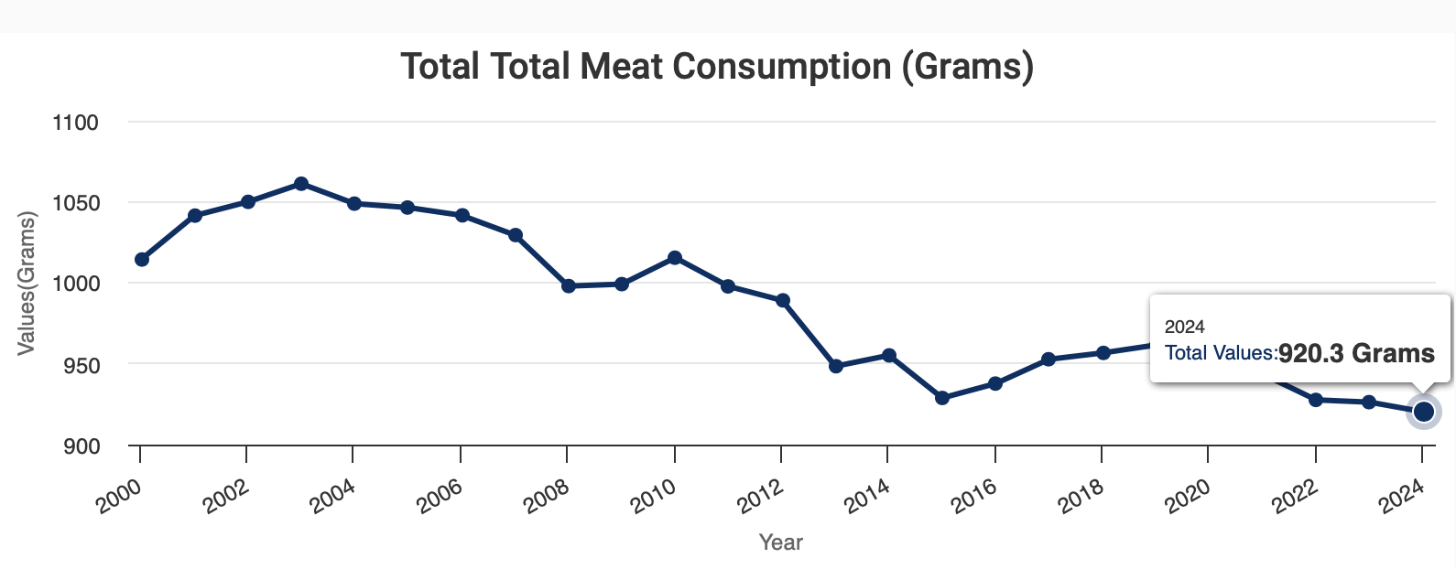

In the UK, Per Capita Meat Consumption has Drifted Down Over the Past 20 Years
But, Meat Market Volume has Grown as Total Population has Increased by 10 Million.
Per Capita Per Week

Slide 12
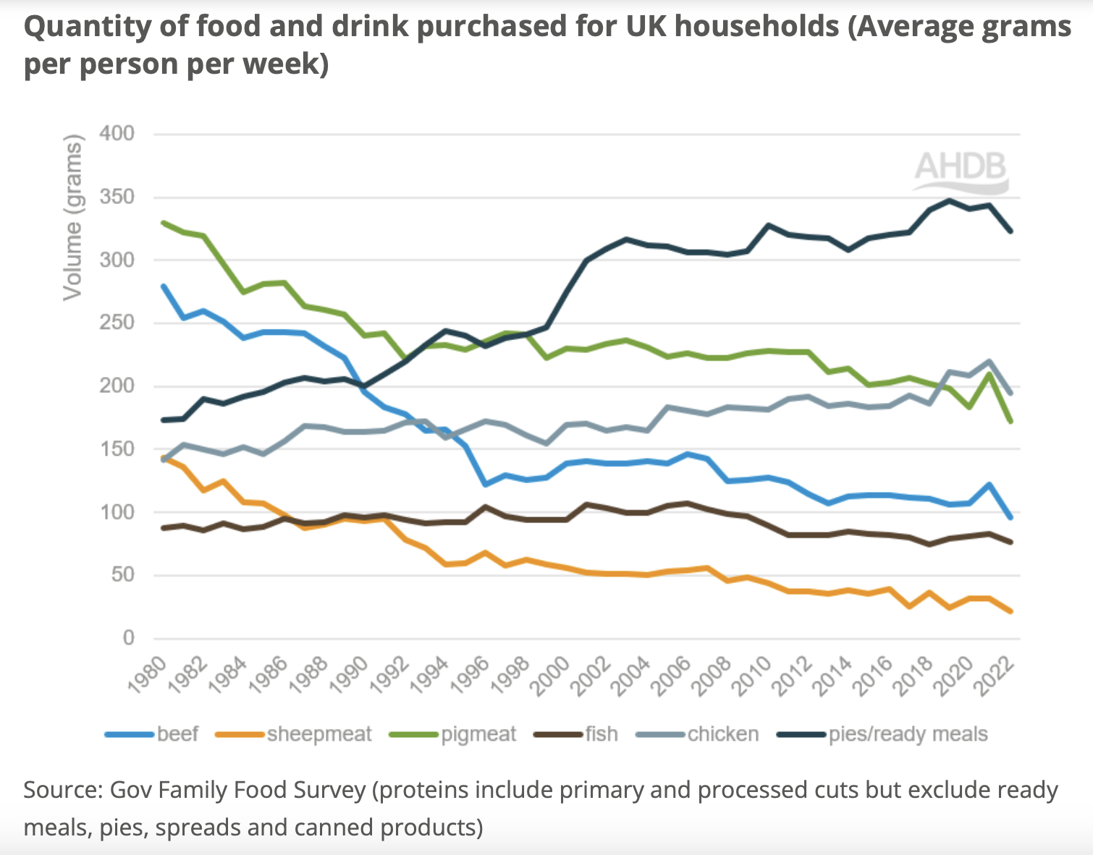

Slide 13

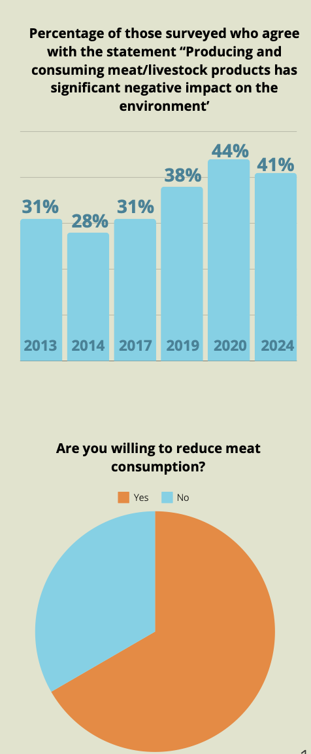
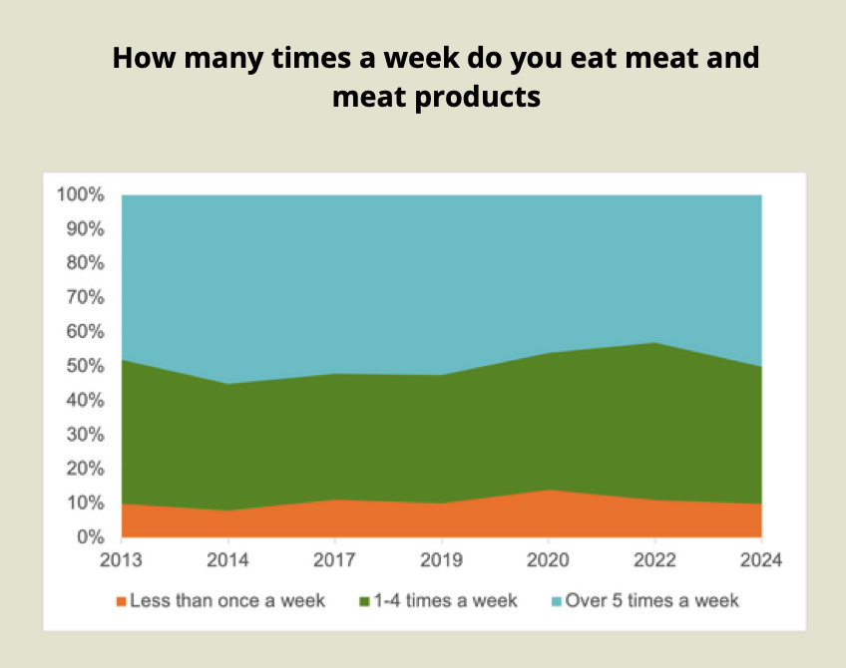
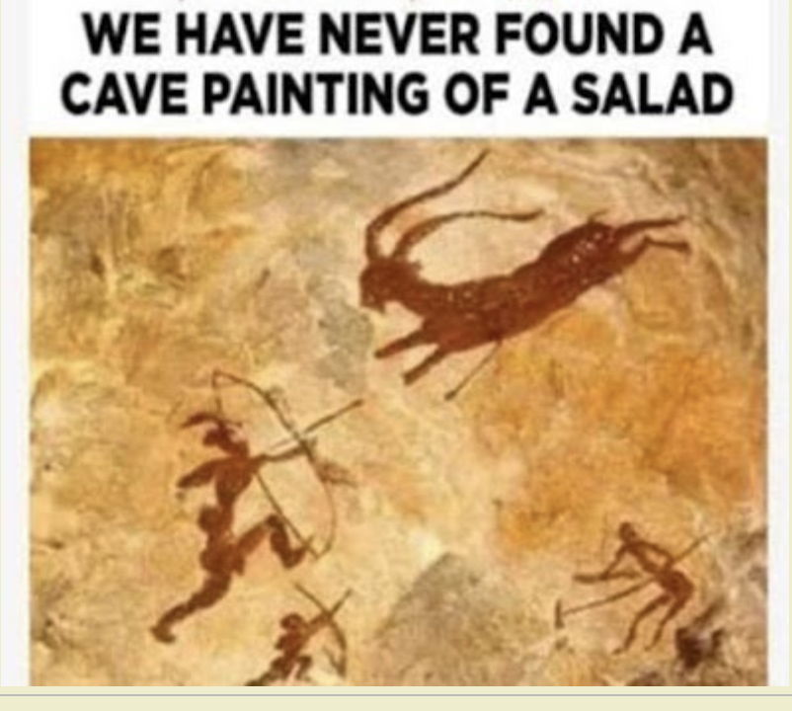

In the UK, We’re Eating
Less Meat Per Person
But We’re Not Eating
Meat Less Times! There’s
Just Less Meat in Processed
Meat & Ready-to-Eat Meals.
Plus, We’re Ageing & having
Smaller Portions!
In Our Genes?!
Check the Median Age in Your Target Market

Slide 14
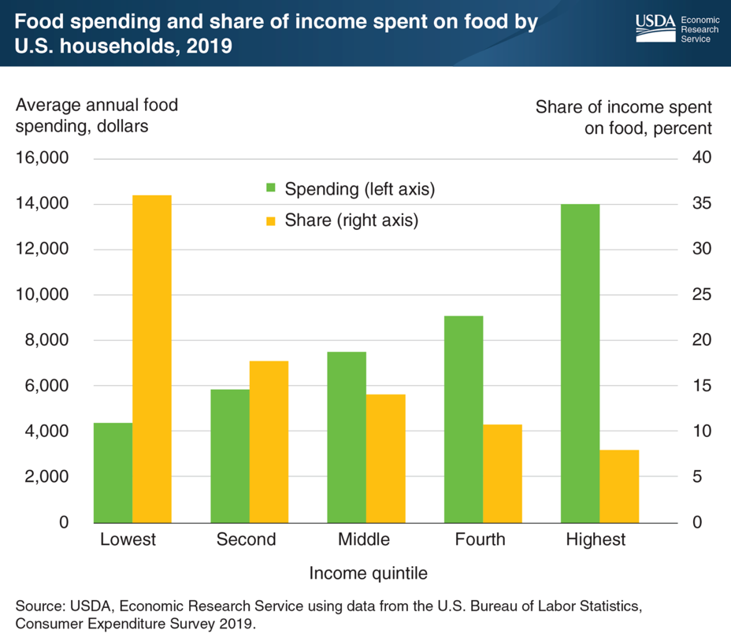
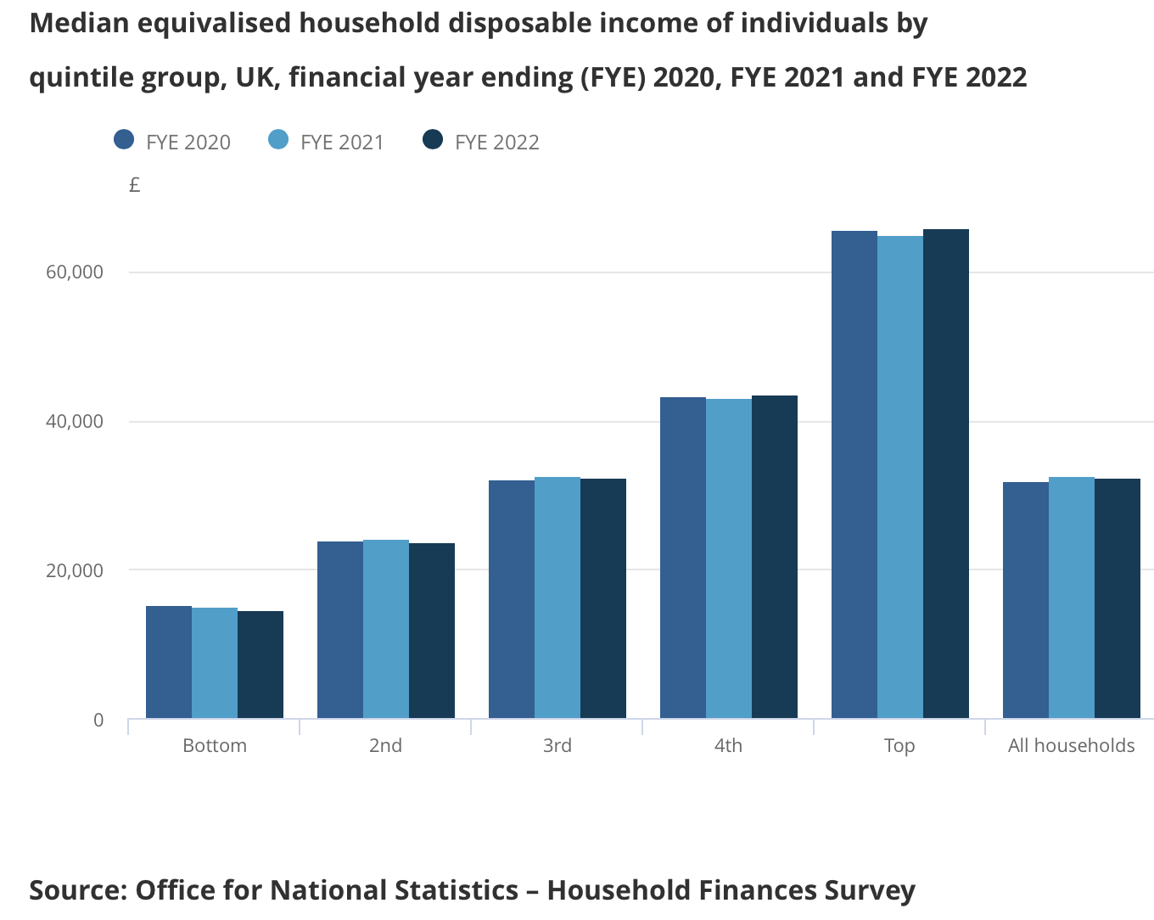

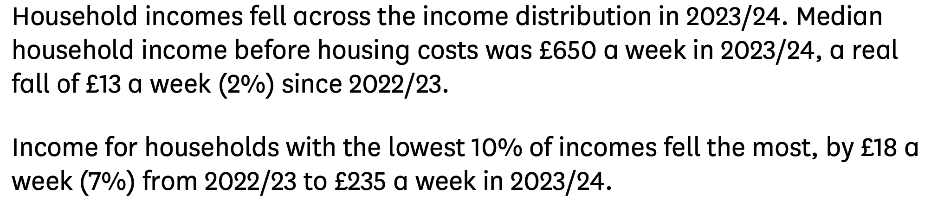
The “Haves” and “Have Nots”
The bottom 20% of households
spend 20+% of income on food
whereas the top 20% spend 5%
Gross Income Per Household in the UK
by Decile Group, 2019/20
The Lowest 20% of Households
Spend 37% of Their Income on
Food Whereas the Top 20%
Spend 7% of Their Income on Food
Polarization of Household Income has Accelerated Over the Past 5 Years Throughout Our World

Slide 15













April 10th, 2025
March 25th, 2025
April 17th, 2025
UK Food Industry Competitive Environment Going Forward? BRUTAL!

Slide 16








Meat for the “Haves” & “Have Nots”
Do You Want to Pay £3 or £66 per Kg.?
Price Hierarchy
Lamb
Beef
Fish
Pork
Chicken
£
Security-Protected
Lamb
Chicken and Lamb: April 20th, 2025
Notes:
4

Slide 17







Join me on a walk around a “please upgrade me” Tesco Extra in Barnstaple, Devon.

Slide 18




Slide 19


Slide 20


Meal Deals

Slide 21



Food Retail and Food Service Converge

Slide 22






It’s About the
Meal Solution
NOT the Hunk
of Meat!
Food Service & Food Retail Converge
“Mains” had Five Times the Retail Shelf Space of Fresh Lamb in Waitrose
Monmouth, November 9th, 2024

Slide 23


A Step Above Private Label: Retail Private Brands
which Compete Much Closer with Restaurant Fare.
April 15th, 2025

Slide 24






The “Restaurant-Equivalent Offer” in Marks & Spencer
Approx. 30% of UK Households 1 Person
and 29% 2 Persons
April 15th, 2025

Slide 25




HelloFresh has 7+m customers worldwide.
Market Cap. €1.43bn (as of April 23rd, 2025)

Slide 26











October 9th, 2024
August 19th, 2024
November 4th, 2024

Slide 27







The Snack & Meal Solution
Store for the Under-40s
October 11th, 2024

Slide 28



April 8th, 2025

Slide 29

April 8th, 2025

Slide 30


The are 752 Product Items in the UK CPI Basket and There are Changes Every Year.
The Changes Reflect Emerging Consumer Trends in Purchasing Behaviour.
2024
2025
*
* Taylor Swift influence.

Slide 31



Monmouth, April 20th, 2024

Slide 32













Meal Type & Carbohydrate Convenience: Important Considerations for Family Hughes!
75p
75p
£1.20
84p
69p
80p
“Instant” Mash & Rice
Become Routine Purchase
84p
89p
90p
£1.10
£1.15
68p
As Diets become more “international”, Traditional Carbohydrate Options may be Squeezed.
For Main Meal Dishes, it’s More about the Sauce than Meat Species. Great for Cheaper Chicken!

Slide 33







Chicken Set to Capitalise on Rise of
Healthy Snacking, High Protein Foods
and Consumers Embracing Mini Meals

Slide 34







Slide 35





In the 1950s
Chicken was for Christmas!
Looking to Grow Your Market?
Add Another Eating Occasion.
Like Brekkie or Any Time Snacking
with Snacks Doubling as Light Meals!

Slide 36


So, What are YOU Going To Do About It? Ooops: The “Say” and “Do” Gap!

Slide 37



* presenteeism: underperformance because overweight
Aussies and Brits are ALL as Round as Puddings and it’ll Cost Us Dearly!

Slide 38






December 16th, 2024

Slide 39









Consumers Retreating on Key Enviro. Actions!

Slide 40

April 8th, 2025

Slide 41



Slide 42


April 3rd, 2025

Slide 43


December 5th, 2024

Slide 44
Globally, Future for Chicken is “Set Fair” with Consumers
Price
Nutrition – protein, low fat
Snack-friendly
Carries flavours well
Across family acceptance
Convenient (relative to other meats)
Very Air-fryable
Enviro. Credentials – carbon footprint
But, don’t frighten the daylights out of consumers with regard:
Technical advances without explaining/gaining permission;
Keeping the hat on AI, i.e. both Avian Influenza and Artificial Intelligence!

Slide 45

CONTACT POINTS:
e-mail: profdavidhughes@aol.com
Telephone contact:
Mobile/Cell +44 (0)7798 558276
Retail Blog: www.supermarketsinyourpocket.com

